Slide 1


Steve Rombough
Oct 2023

Slide 2

Outline
Executive Summary
Introduction
Methodology
Results
Conclusion
Appendix

Slide 3
Executive Summary
To determine if SpaceY can make space travel more affordable a major component is to determine how frequently the first stage of rocket launches can be reused.
To understand this issue data is pulled from various SpaceX sources and webscraping was employed to pull launch results from a number of SpaceX launch sites. These launch outcomes show the success rate of launches using different factors including booster version, orbit type, landing location, and payload mass.
Upon wrangling the data it was fit to various model techniques and rerun under various parameters to optimize model accuracy. After all models were run the model with the most accuracy is chosen.
For SpaceY to be a competitive company they should employ a decision tree model which had an 89% accuracy score. A launch site in southeast Florida with conditions similar to KSC LC-39A is ideal. A focus should be put on payloads not exceeding 5,500KG with FT boosters will build a reputation of success and draw more funding.

Slide 4
Introduction
To determine if SpaceY can make space travel more affordable a major component is to determine how frequently the first stage of rocket launches can be reused. Using data from SpaceX to identify what factors lead to the greatest likelihood of a successful launch and successful landing will allows SpaceY to focus their purpose. By building a reputation of success SpaceY can build a strong foundation on which build goodwill to lead to our own exploratory testing.
This presentation looks to address the following issues:
Where is the best location for a launch site and landing site?
Which orbits maximize the likelihood of success?
What is the maximum payload mass before a launch is too risky?
What boosters increase success rate depending on payload mass?

Slide 5

Section 1

Slide 6
Methodology
Executive Summary
Data collection methodology:
Describe how data was collected
Perform data wrangling
Describe how data was processed
Perform exploratory data analysis (EDA) using visualization and SQL
Perform interactive visual analytics using Folium and Plotly Dash
Perform predictive analysis using classification models
How to build, tune, evaluate classification models

Slide 7
Data Collection
Data was collected from SpaceX URLs and web scraping from wiki pages of SpaceX Launch data
Detailed data collection methodology is explained in the following slides using key phrases and flowcharts

Slide 8
Data Collection – SpaceX API
For External reference please click on the following GitHub URL link
coursera/jupyter-labs-spacex-data-collection-api.ipynb at main · SteveRombough/coursera (github.com)
Place your flowchart of SpaceX API calls here
Import SpaceX URL
Request and Parse data from JSON file
Normalize JSON data into a Pandas Dataframe
Build lists from the API using launch IDs
Filter to Falcon 9 Launches and replace nulls with field averages

Slide 9
Data Collection - Scraping
Request Falcon9 Launch Wiki page from URL
Create a BeautifulSoup object from the HTML
Extract all field names from HTML table header
Create a dataframe by parsing Launch HTML tables
Dataframe built from dictionary populated by keys in the tables

Slide 10
Data Wrangling
Data wrangling is the process for cleaning data, i.e. account for missing values, correct typos, assign binary values to categorical fields
For this project there were various landing outcomes leading to success or failure. Creating a new variable ‘landing_class’ and assigning a value of 0 or 1 to the dataframe provides a target variable to model towards.
coursera/labs-jupyter-spacex-Data wrangling.ipynb at main · SteveRombough/coursera (github.com)
Place your flowchart of SpaceX API calls here
Import Libraries and Define Auxiliary Functions
Identify numerical & categorical fields
Identify and calculate average values to replace Nulls
Use .value_counts() to assign proportions for categorical fields
Create binary fields to determine if a launch is a success or not

Slide 11
EDA with Data Visualization
Scatter Plots
Payload Mass vs Flight Number
Launch Site vs Flight Number
Launch Site vs Payload Mass
Orbit vs Flight Number
Orbit vs Payload Mass
Scatter Plots show relationships between descriptive fields. The following comparisons were made to visualize how the fields interact:
Bar Charts can easily visualize how categorical field values compare by magnitude. This project created Success Rate by Orbit Type
Line Graphs visualize trends over time. This project plots Success Rate over Launch Year
https://github.com/SteveRombough/coursera/blob/main/jupyter-labs-eda-dataviz.ipynb.jupyterlite.ipynb

Slide 12
EDA with SQL
This presentation will show how to pull the following SQL queries:
Display unique launch sites
Display 5 records with launch sites beginning with ‘CCA’
Display total payload mass carried by NASA boosters.
Display average payload mass carried by booster version F9 v1.1
List the date of the fist successful landing outcome on a ground pad
List successful boosters on drone ships with payload between 4k-6k KG
List total number of successful and failure mission outcomes
List booster versions that carried maximum payload mass
List records of failed landings on drone ship in 2015
Rank landing outcomes in descending order between Jun 2010 and Apr 2017
https://github.com/SteveRombough/coursera/blob/main/jupyter-labs-eda-sql-coursera_sqllite.ipynb

Slide 13
Build an Interactive Map with Folium
For the folium map I highlighted using circles the respective launch sites and whether launches within the sites were successful or failure using markers.
I identified railways, highways, nearby cities, and hospitals with markers and added lines on the map to show distance from the launch site. As a bonus the distance in KM is added to each line.
https://github.com/SteveRombough/coursera/blob/main/lab_jupyter_launch_site_location.jupyterlite.ipynb

Slide 14
Build a Dashboard with Plotly Dash
The Plotly dashboard shows interactive pie charts that show success rates of the launch sites altogether and within each launch site.
A payload slider scale was included to customize scatterplots showing the success rates of launches vs payloads within each launch site.
This plots and interactions help one drill down into each variable to find the most successful combinations
https://github.com/SteveRombough/coursera/blob/main/spacex_dash_app.py

Slide 15
Predictive Analysis (Classification)
Import numpy, pandas, matplotlib, seaborn, and sklearn libraries
Using the flowchart to the right the data is prepped and fed into a GridSearchCV object.
For each model type: Linear regression, Support Vector Machine, Decision Tree, K Nearest Neighbors a custom parameter list is created
The GridSearchCV takes the parameter ranges and reruns the model process finding the optimum parameters.
An accuracy score and confusion matrix are prepared to display results
Https://github.com/SteveRombough/coursera/blob/main/SpaceX_Machine_Learning_Prediction_Part_5.jupyterlite.ipynb
Create confusion matrix plot function
Create a numpy array from the dataframe using Class as target variable
Standardize data using preprocessing. StandardScaling function
Create training and test data sets using train_test_split function
Build GridSearchCV object with parameter ranges to search for best results

Slide 16
Results
Exploratory data analysis results
Interactive analytics demo in screenshots
Predictive analysis results

Slide 17

Section 2

Slide 18
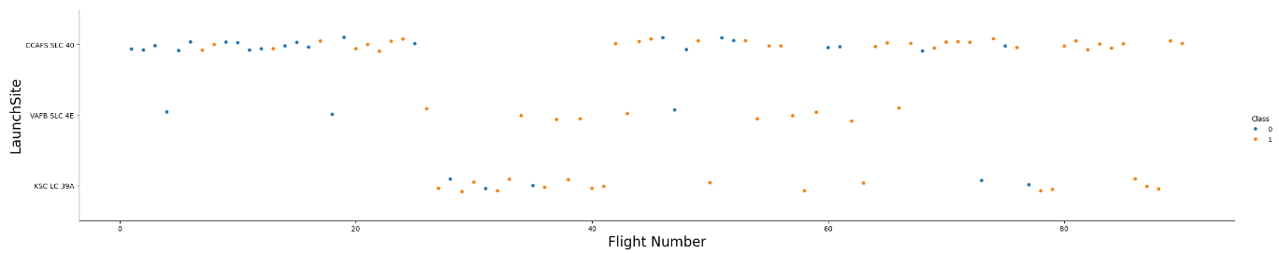
Flight Number vs. Launch Site
Show a scatter plot of Flight Number vs. Launch Site
Launch Site CCAFS SLC 40 had a poor success rate, <40%, as the beginning launch site
Launch sites VAFB SLC 4E and KSC LC 39A showed significant improvement. Favorable weather conditions along with technology refinements played a role.
Launch rate has improved to 85%, 17 of last 20 launches, at CCAFS SLC 40 due to technology advancements

Slide 19
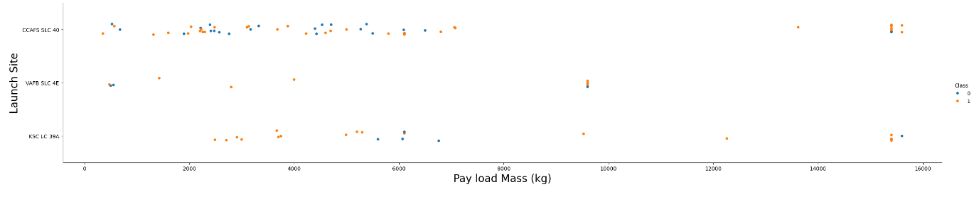
Payload vs. Launch Site
Show a scatter plot of Payload vs. Launch Site
At CCAFS SLC 40 payload was not a determinant of launch success, however the success rate improved with payloads over 12,000kg.
VAFB SLC 4E showed success when payload was > 1,000kg, but maxed out shy of 10,000kg
KSC LC 39A succeeded in payloads < 5,000kg and >9,000 kg but struggled inbetween.

Slide 20
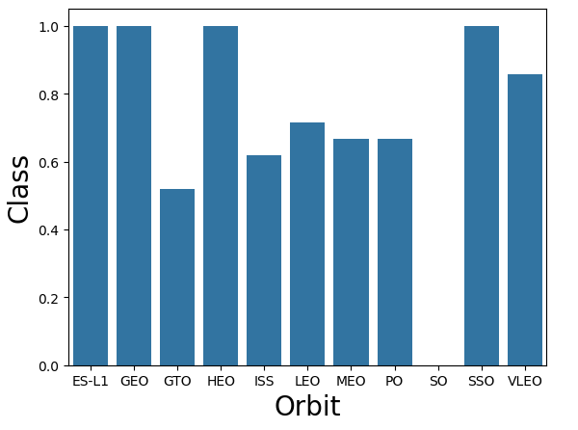
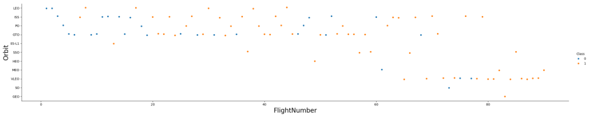
Success Rate vs. Orbit Type
The success rates are deceiving as ES-L1, GEO, HEO, and SO only had one launch each.
The scatterplot below shows VLEO and ISS orbits are proving to be more reliable launches especially as more are completed.

Slide 21
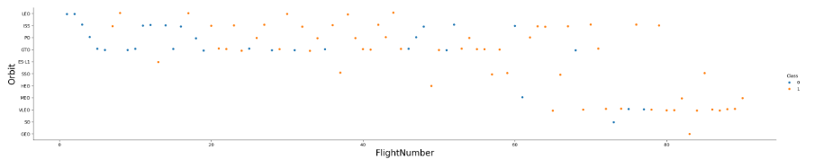
Flight Number vs. Orbit Type
Show a scatter point of Flight number vs. Orbit type
GTO, ISS, and PO proved to strong training for launches with GTO having the least success.
New ventures into VLEO orbit have proven repeatable with the last 9 launches being a success.

Slide 22
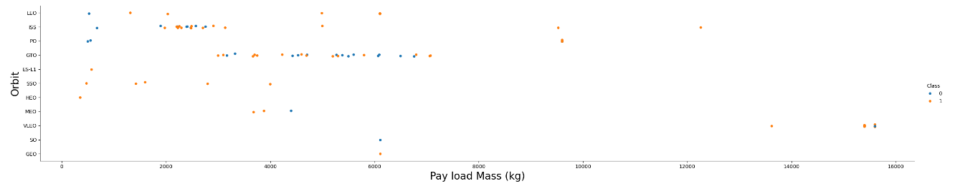
Payload vs. Orbit Type
Show a scatter point of payload vs. orbit type
Payload and Orbit have proven to be quite correlated with most orbits requiring >500kg to be successful.
VLEO has proven to be successful while also carrying more payload than other launches.

Slide 23
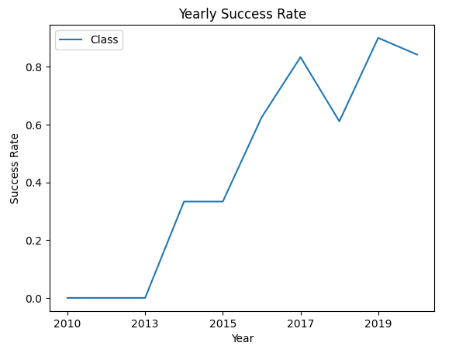
Launch Success Yearly Trend
Every launch is a learning case and enables to test boundaries.
With every jump in technology some setbacks can occur as calculations need to be calibrated for orbit, payload, and location.
Within 6 years the success rate has jumped from <40% to ~85%

Slide 24
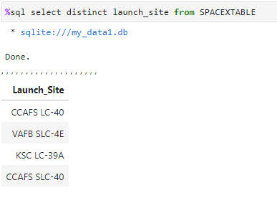
All Launch Site Names
VAFB SLC-4E is the SPACE X launch site in California found Northwest of Los Angeles.
The remaining launch sites are all found in Southeast Florida.

Slide 25
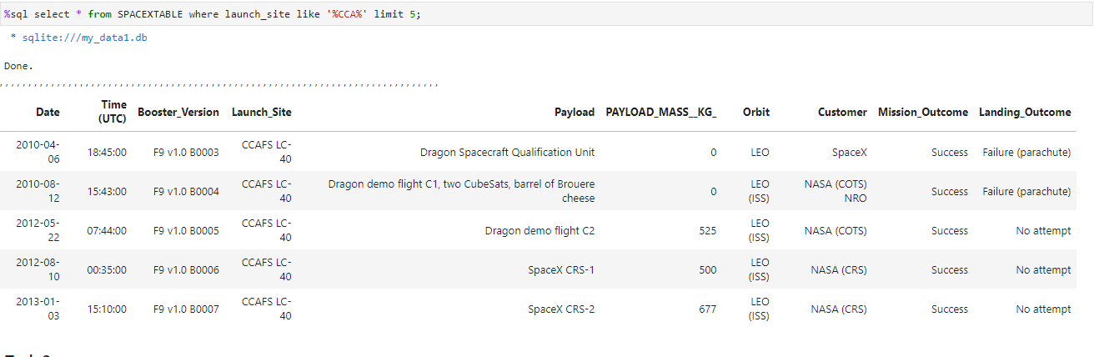
Launch Site Names Begin with 'CCA'
The first 5 launches from CCAFS LC-40 were sent to LEO Orbit with small payloads.
All these launches saw the rocket was unable to land.

Slide 26
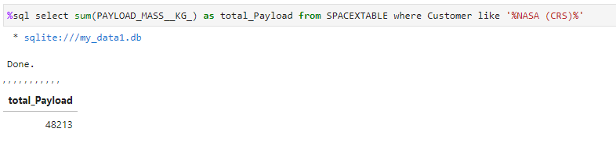
Total Payload Mass
Calculate the total payload carried by boosters from NASA
Across all the launches NASA boosters carried 48,213kg in payload!

Slide 27
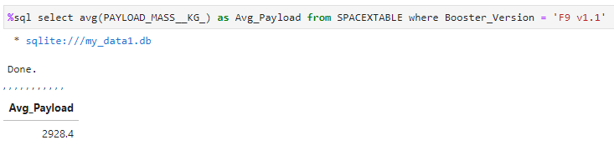
Average Payload Mass by F9 v1.1
Calculate the average payload mass carried by booster version F9 v1.1
The booster version F9 v1.1 should be used for lighter launches. The average payload was 2,928kg.

Slide 28
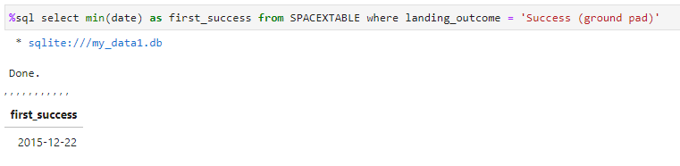
First Successful Ground Landing Date
Find the dates of the first successful landing outcome on ground pad
An historic first on Dec. 22nd 2015 as the first successful landing back to a ground pad occurred.
This landing occurred a mere 5 years after Space X’s first launch.

Slide 29
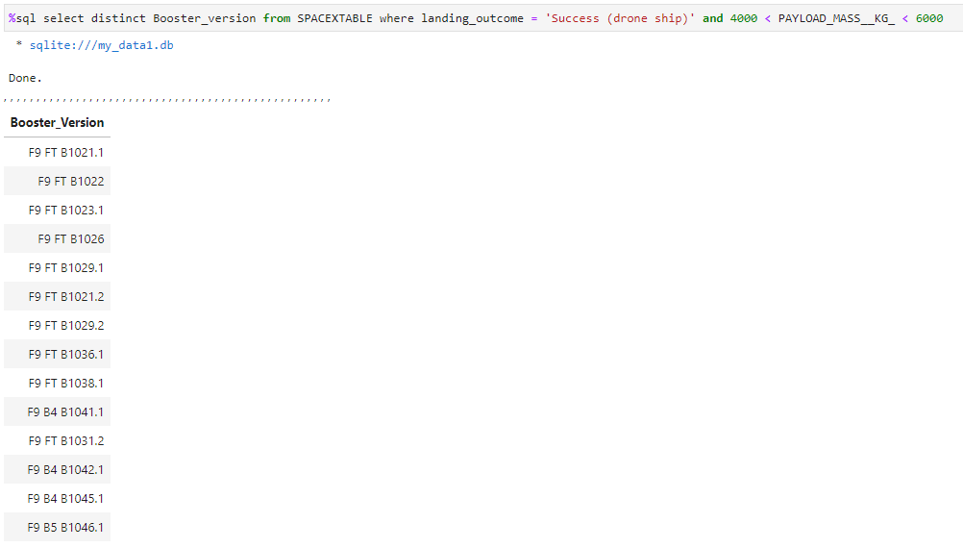
Successful Drone Ship Landing with Payload between 4000 and 6000
To the left are boosters which have successfully landed on drone ship and had payload mass greater than 4,000kg, but less than 6,000kg
These boosters continue to pave the way for future successful launches and landings as multiple boosters can be relied upon to land on drone ships.

Slide 30
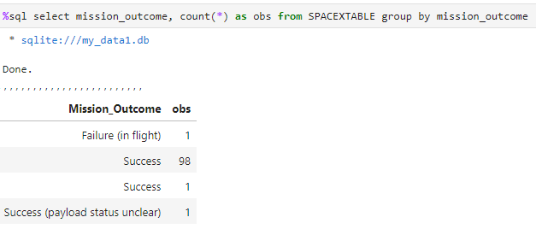
Total Number of Successful and Failure Mission Outcomes
Not all missions are created equal as failed landing may not constitute a failed mission.
If the launch reached orbit, reached location with payload, or successfully landed all can be considered successes depending on the data intended to be garnered.
Only one of the 101 SPACE X missions webscraped from wiki were considered a failure.

Slide 31
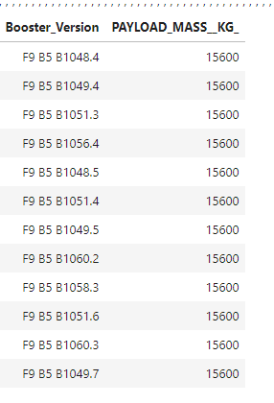
Boosters Carried Maximum Payload
To the left are the names of the boosters which have carried the maximum payload mass of 15,600kg
This shows multiple boosters are capable of handling the max payload and that the technology is relatively easy to replicate.

Slide 32
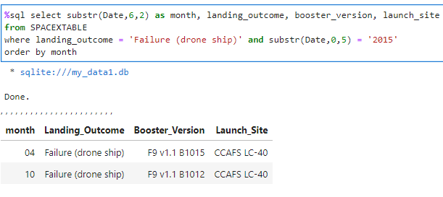
2015 Launch Records
In 2015 only twice did Space X fail to land on a drone ship.
These failed landings used booster versions B1015 and B1012 of the F9 V1.1 variety.
Both failed landings occurred in CCAFS LC-40 launch site

Slide 33
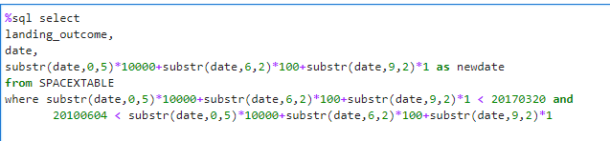
Rank Landing Outcomes Between 2010-06-04 and 2017-03-20
Between Jun 2010 and Mar 2017 the most common landing outcome is ‘No Attempt’ where it was never intended.
Drone ship landings have proven tricky with a 50% success rate.
Landing Outcome | Count
No Attempt | 10
Success (drone ship) | 5
Failure (drone ship) | 5
Success (ground pad) | 5
Controlled (ocean) | 3
Uncontrolled (ocean) | 2
Precluded (drone ship) | 1
Failure (parachute) | 1

Slide 34

Section 3

Slide 35
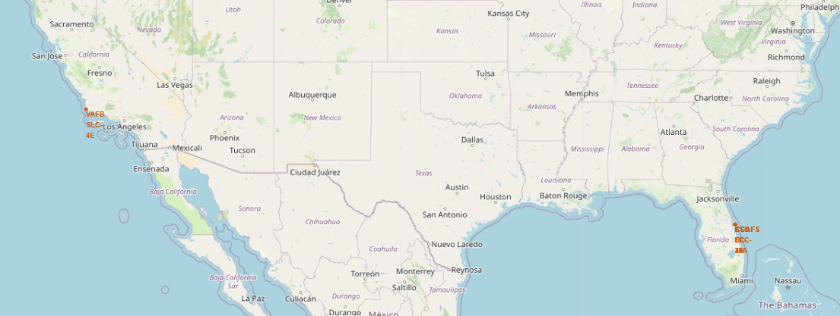
SpaceX Launch Sites
VAFB SLC-4E is the SPACE X launch site in California found Northwest of Los Angeles.
The remaining launch sites are all found in Southeast Florida.

Slide 36
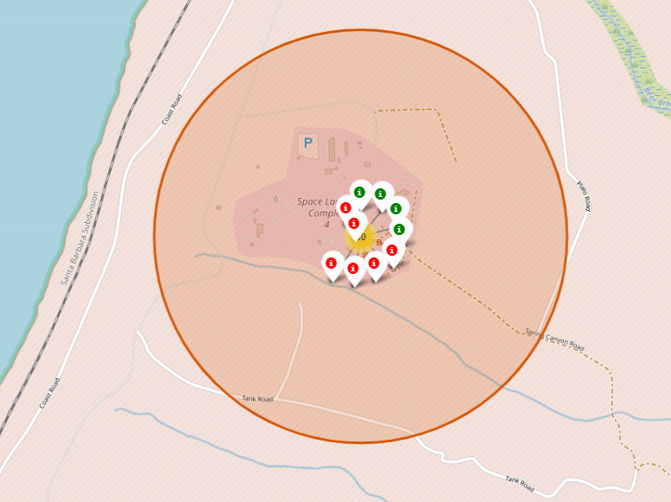
California Launch Outcomes
VAFB SLC-4E is the SPACE X launch site in California found Northwest of Los Angeles.
It is the site of 10 launches with 4 having been successful

Slide 37
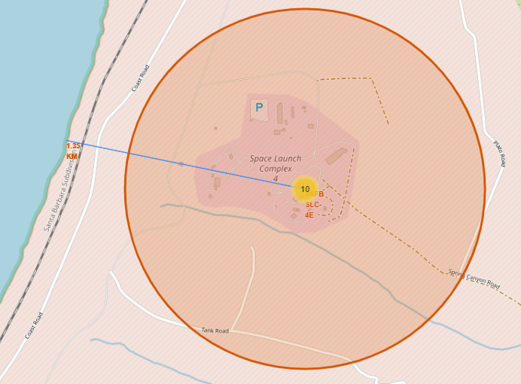
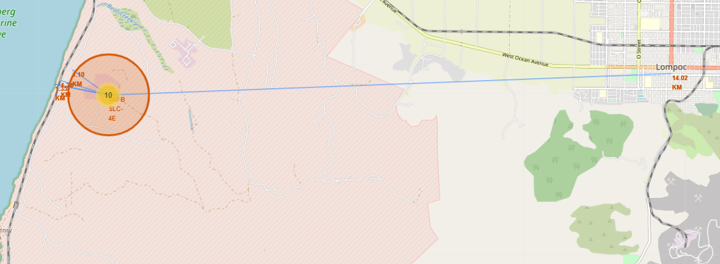
California Launch Site proximities
The California site is ideal as it has:
Strong access via railway and highway
Close to a coastline; in the event of a crash the wreckage is safest in the ocean
Further to safety the site must maintaining distance from large metropolitan areas

Slide 38

Section 4

Slide 39
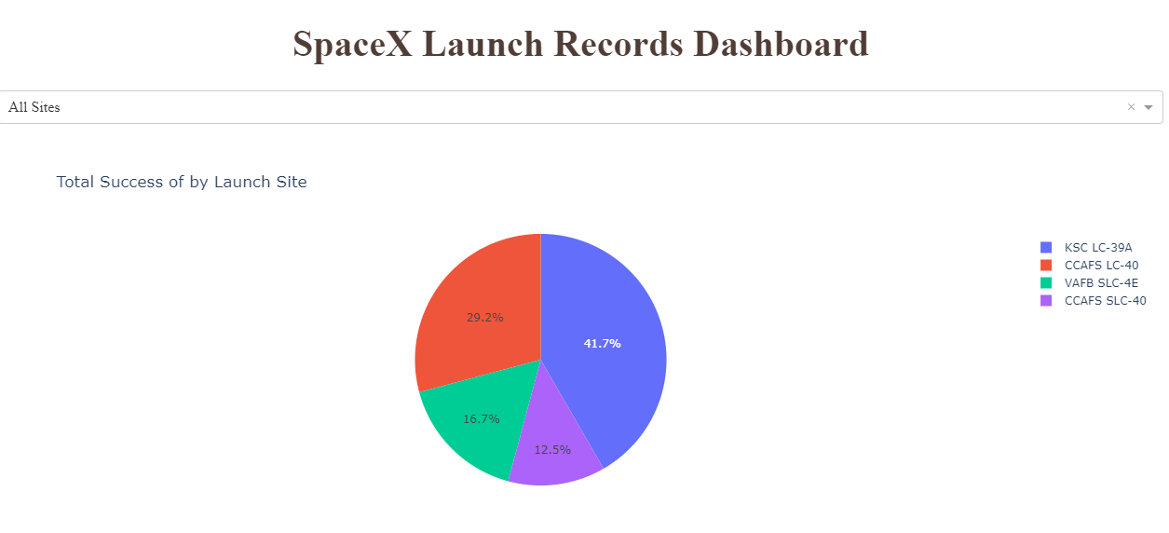
Successful Launch Records
KSC LC-39A is the most successful launch site making up 41.7% of all successful launches.
Comparatively CCAFS SLC-40 had the least number of successful launches, 12.5%

Slide 40
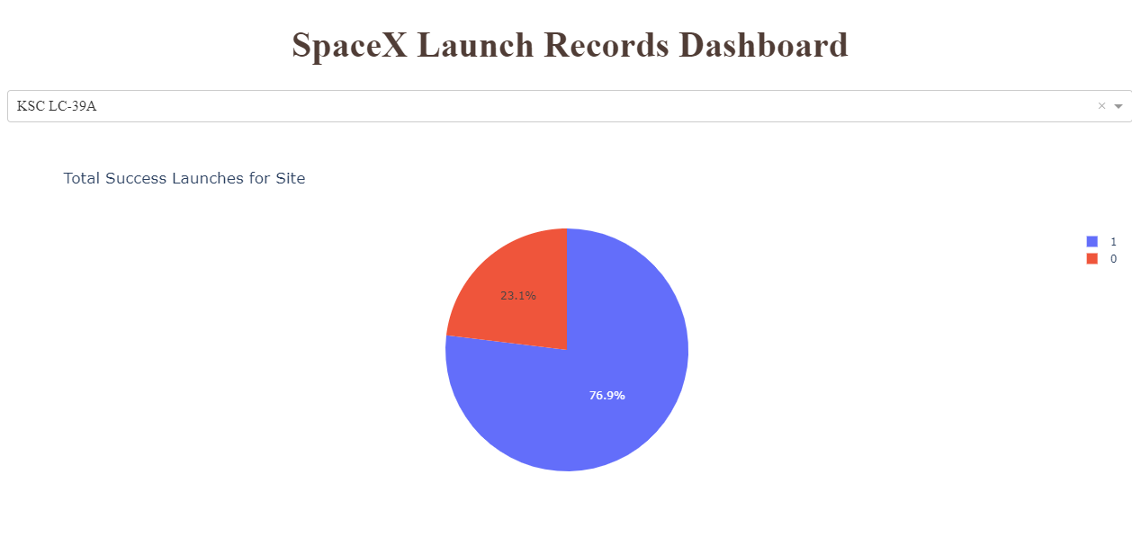
Highest Success Rate
KSC LC-39A is successful 76.9% of the team.
This far surpasses the success rate any other launch site.
The 3 other all had < 50% success.

Slide 41
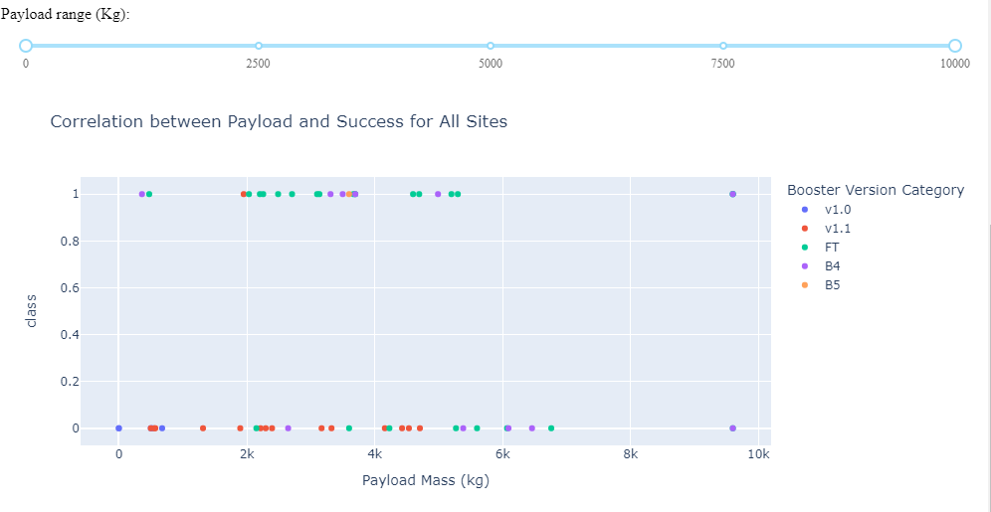
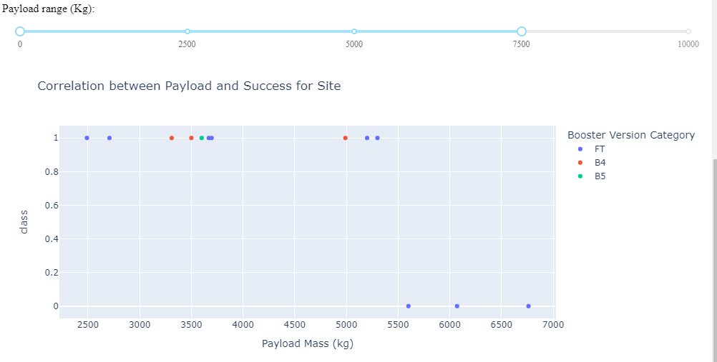
Payload v Launch Outcomes
The payloads with the most successes were in the 2,000kg-6,000kg range
Booster Version FT proved to be the most successful; B4 had a success at the payload of 9,600Kg but also a failure.
For successful site KSC LC-39A their launches were all a success until payload exceeded 5,500kg. This could come down to Booster Version FT not being able to handle the weight.

Slide 42

Section 5

Slide 43
Classification Accuracy
Out of all the model attempts the highest classification accuracy belonged to the Tree Model at 89%

Slide 44
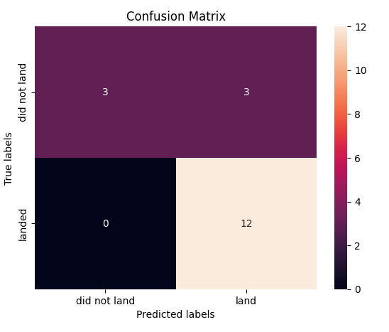
Confusion Matrix
The confusion matrix showed strong for correctly picking landings as all landings were correctly predicted.
The model however mispredicted 3 of the failures out of 6.

Slide 45
Conclusions
A location in Southeast Florida is optimal with conditions similar to launch site KSC LC-39A
Payloads with the most successes were in the 2,000kg-6,000kg range
Booster Version FT proved to be the most successful; Stay away from Booster v1.1!!!
These factors suggest flights to ISS should be the main focus
When building predictive analysis models the Decision Tree model technique has proven to be more accurate for this issue

Slide 46
Appendix
Data can be found in the links within the body of the presentation
The data used for the Plotly interactive charts can be found in the following link
https://github.com/SteveRombough/coursera/blob/main/spacex_launch_dash.csv

Slide 47


